Slide 1
Modeling Data Validations
https://github.com/sheshankkodam/json-validations

Slide 2
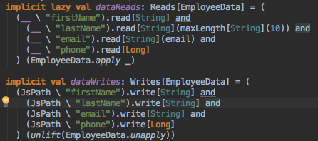
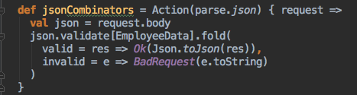
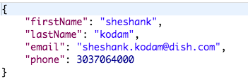
Json Combinators

Slide 3
Json Combinators
Pros
No boilerplate code
Default validation functions like max, minLength etc are available
Cons
Complicated data structure on failures
Difficult to add custom validations

Slide 4
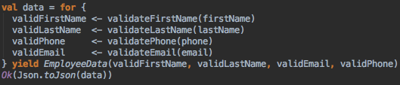
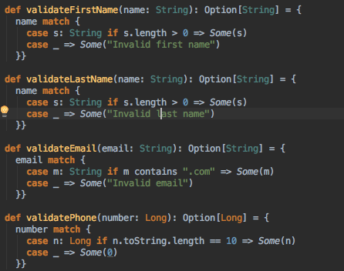
Options

Slide 5
Options
Pros
Custom validation can be added easily
Multiple validation results can be shown
Cons
Difficult to read failures
Process continues on failures

Slide 6
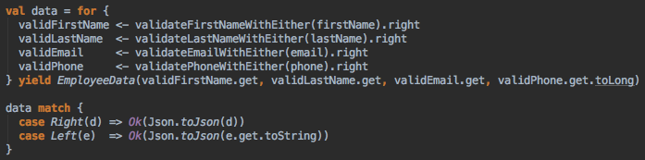




Either

Slide 7
Either
Pros
Custom validation can be added easily
System doesn’t need to go through the entire process on failures
Cons
Shows one failure at a time

Slide 8

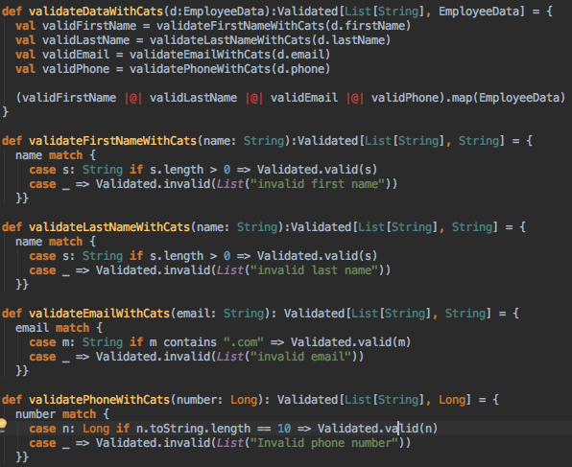
CATS

Slide 9
CATS
Pros
Custom validation can be added easily
System doesn’t need to go through the entire process on failures
Failures can be handled easily
Cons
Doesn’t show reasons for failure

Slide 10

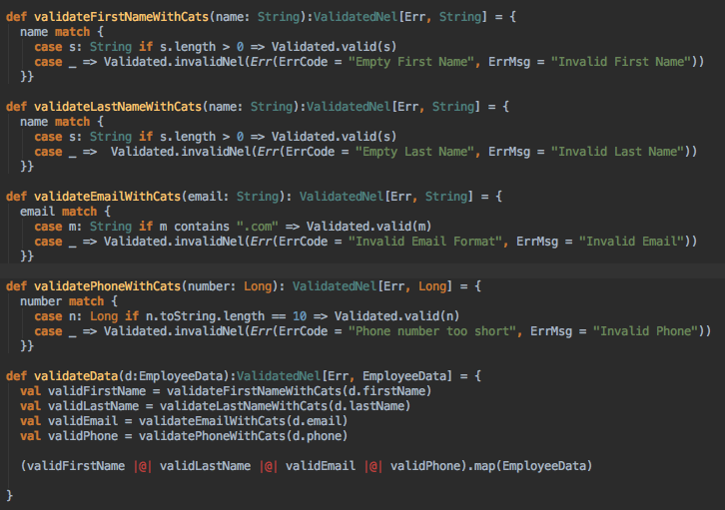
CATS Nel…

Slide 11
Final Solution Recommended
Use Json Combinators + CATS

